Slide 1
Angular Final Project
Role Assigning Portal

Slide 2
Environment SETUP
Images
Nginx Server
http://localhost:8086/
Data
json-server-auth
json-server-auth --port 4500 data.json
http://localhost:4500/
Output – Browser
http://localhost:4200/

Slide 3
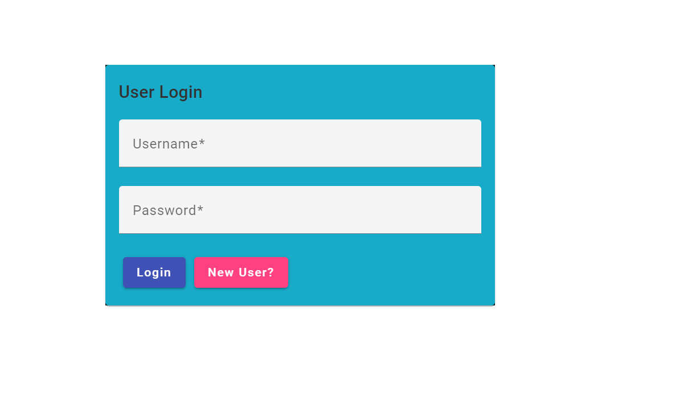
Login Page
I

Slide 4
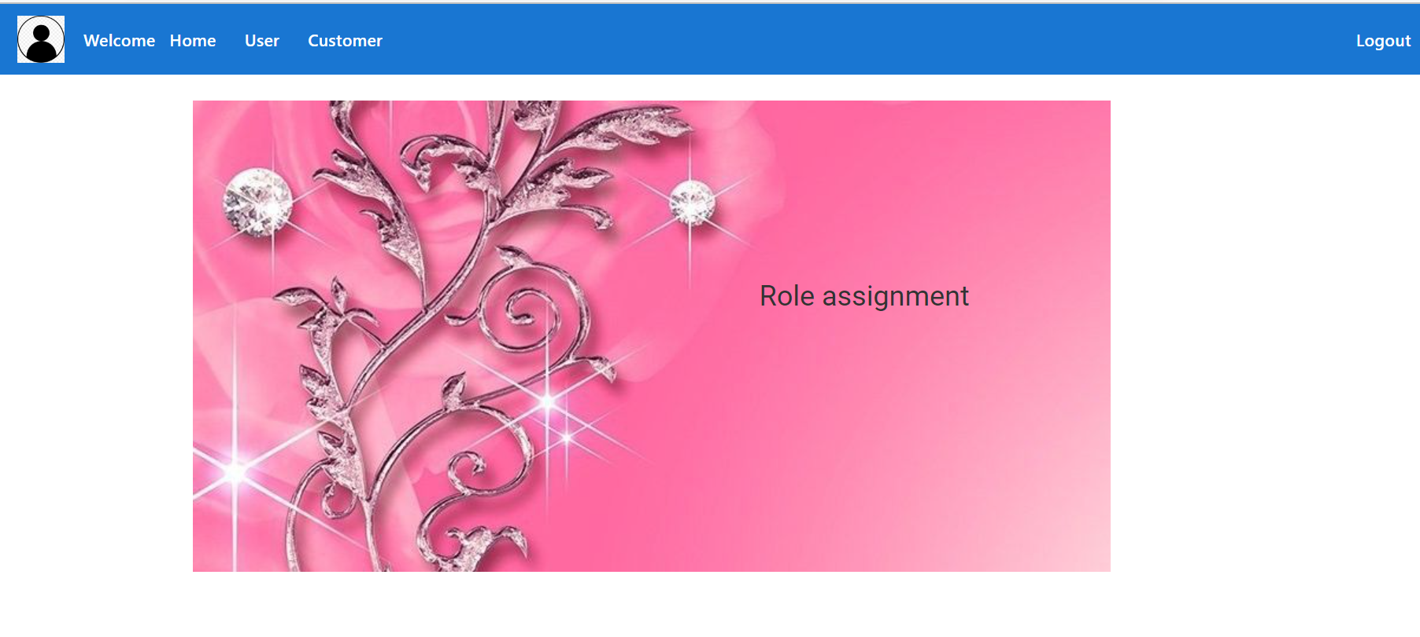
Home Page – Admin Role

Slide 5
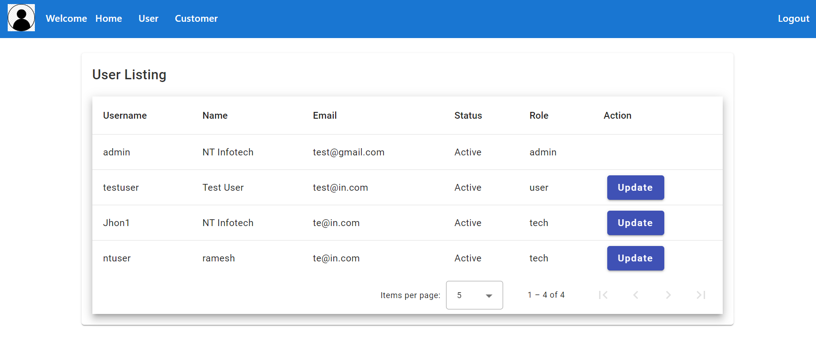
User menu click

Slide 6
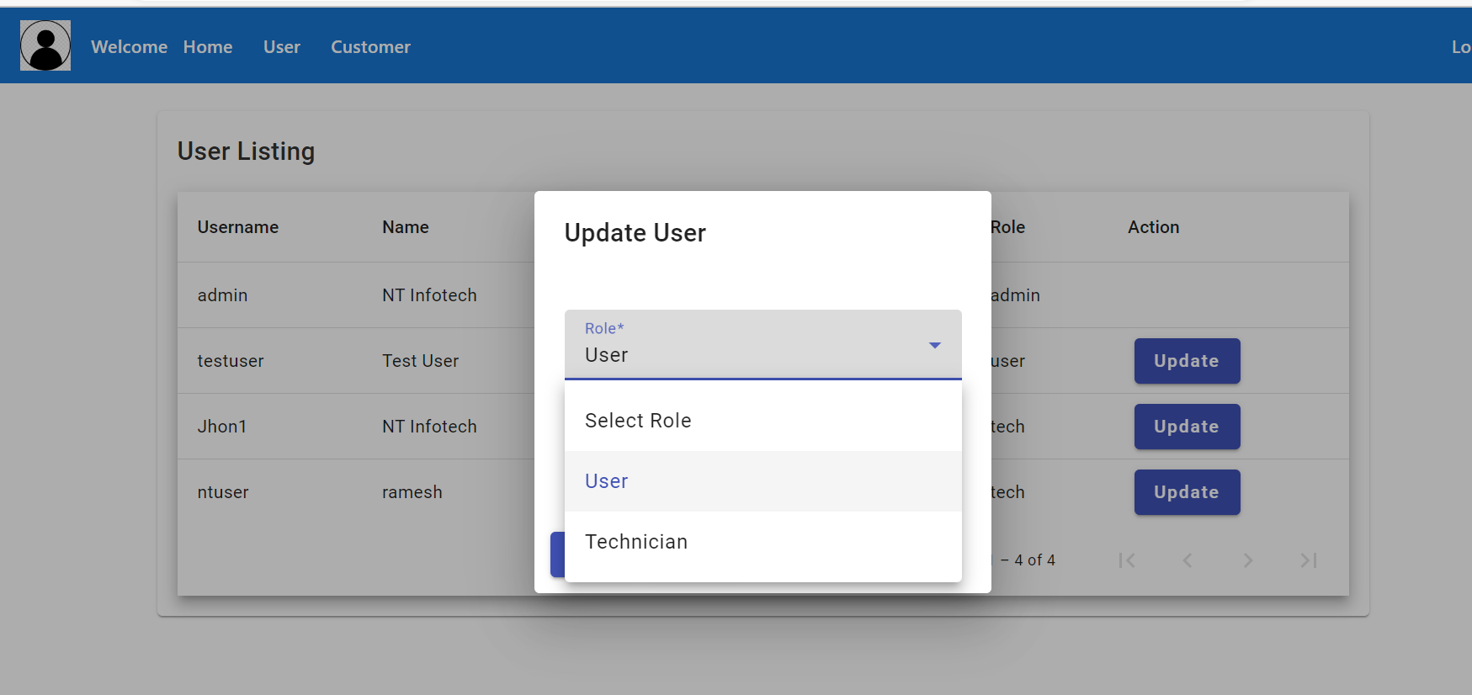
ListingUser role

Slide 7
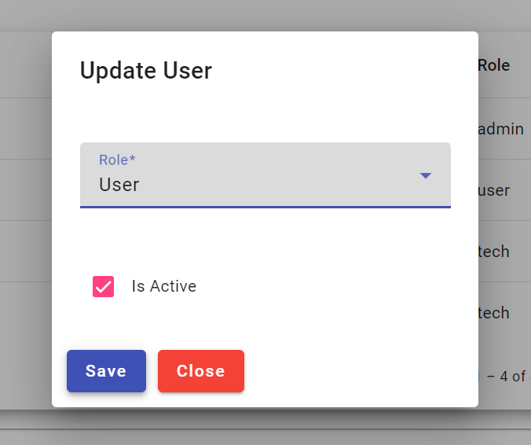
Updating user role

Slide 8
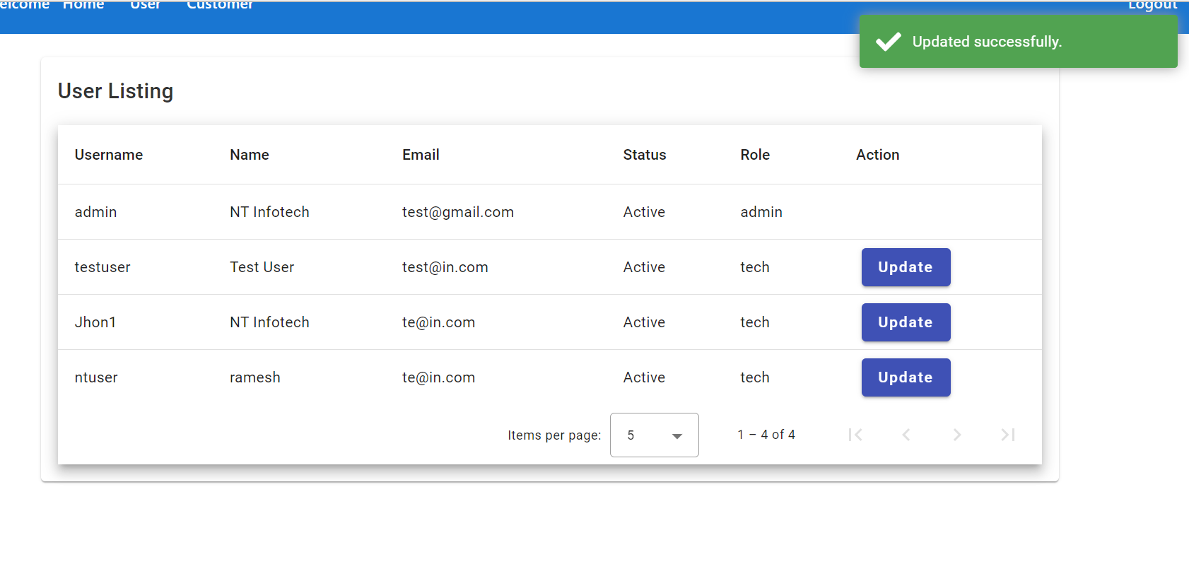
Updated

Slide 9
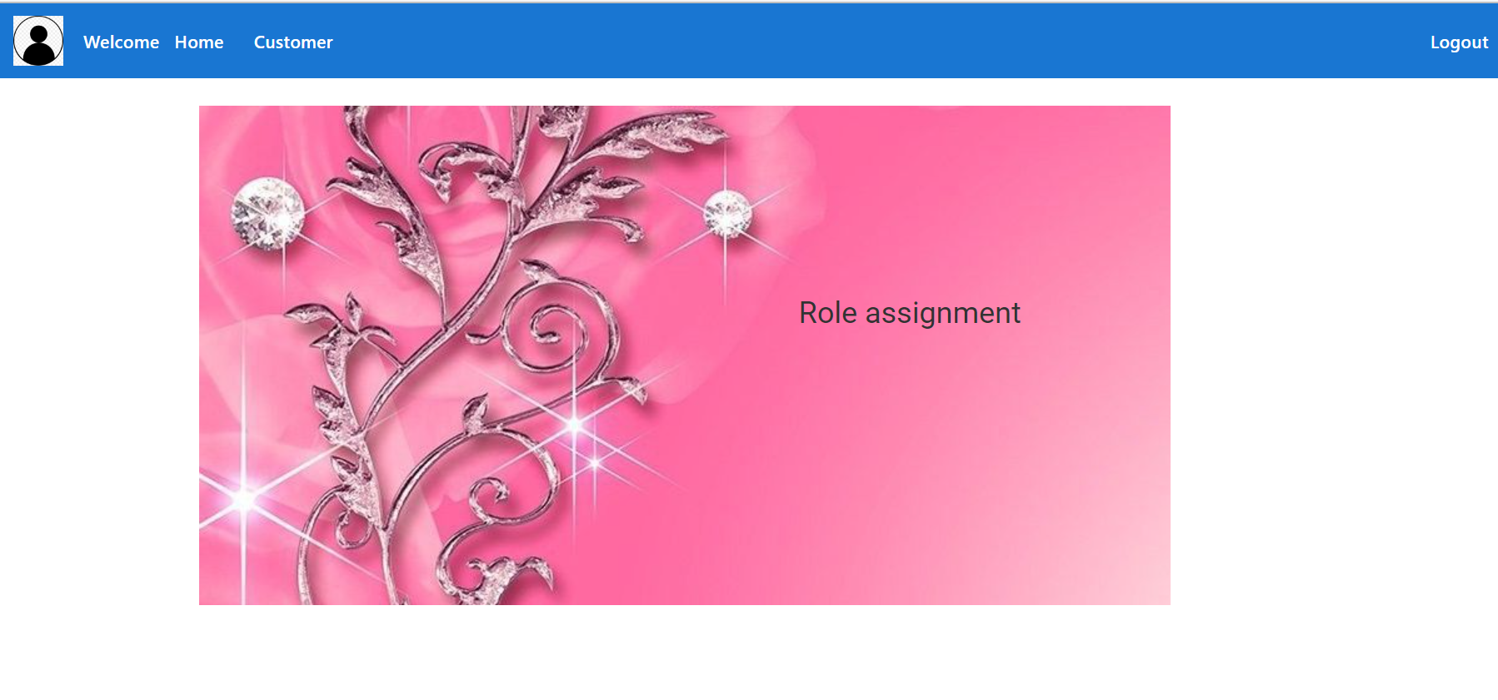
Home Page – User Role

Slide 10
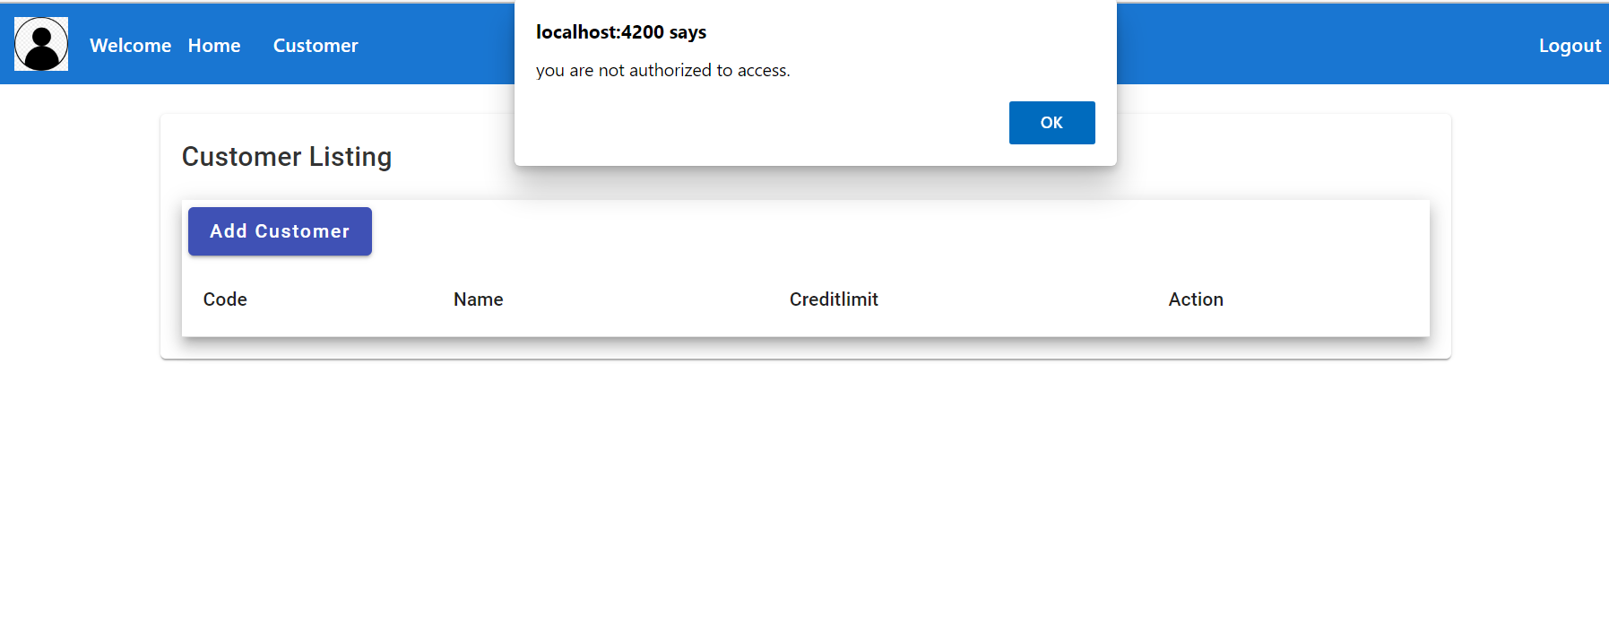
Access denied when user add customer

Slide 11
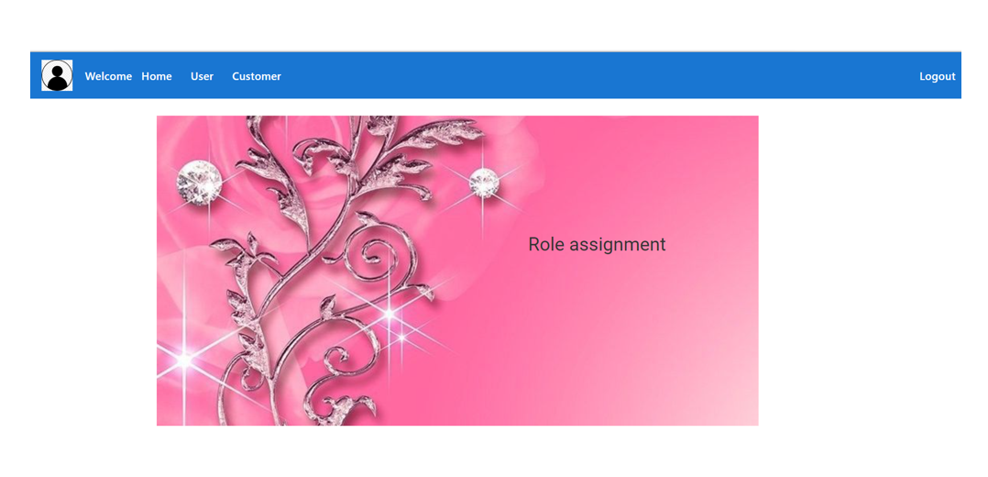
Logout

